Slide 1

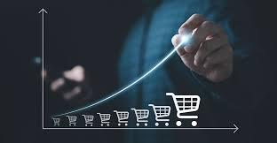
Ecommerce Sales
PRESENTED BY-
•HIMANSHI

Slide 2

INTRODUCTION
Welcome to our presentation, which tells us about the ecommerce business and the reason behind growing, using data analytics.
Using Power BI and Machine Learning, we have carefully evaluated E-commerce data to uncover valuable insights that can help shape strategic decision-making in developing ecommerce business.
In this presentation, we will take you on a journey around the commerce allows consumers and businesses to transact through online platforms, eliminating the need for physical stores and enabling a more extensive reach to global markets.
E-commerce sales are a dynamic and integral part of the modern economy, enabling businesses and consumers to engage in transactions seamlessly across the globe. By leveraging the internet and digital technologies
E-commerce sales offer unparalleled convenience, variety, and reach, driving significant changes in how commerce is conducted. Understanding its components, models, and metrics is essential for anyone involved in or studying this field.

Slide 3
Project Overview
:
This presentation aims to show how Power BI and Machine Learning were used to analyze E-commerce business data in great detail. We hope to accomplish the following by focusing Machine Learning reliable strength with BI's analytical capabilities.
Discover important insights: Examine the details of E-commerce business data to find patterns, trends, and outliers that offer insightful information on market.
To improve decision-making in the e commerce business, provide relevant and useful information to enterpreneurs so they may formulate and implement effective marketing plans, product offers, and operational efficiency
Effectively visualize data by presenting complex investment data in an understandable and straightforward manner using the interactive visualizations and dashboards built with Power BI. This will allow enterpreneurs to quickly discover more information.
Data Cleaning and Preprocessing Steps :
Handling null values
Removing duplicates
Delete irrelevant features
Checking Data types
Add some new features
Making new tables according to my needs
Background Design in Power Point
Generate KPI’s
Importing images
Dashboard Building
Make buttons for page Navigation
Uncover insights

Slide 4
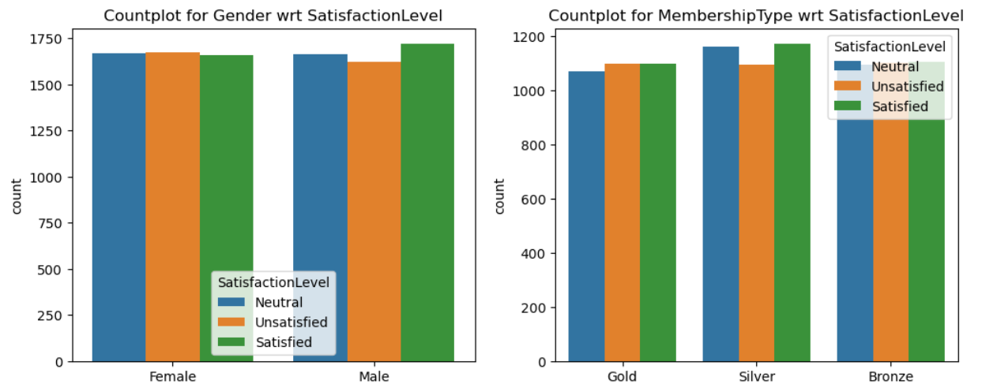
Visualization
We can compare the differences of Satisfaction level for each gender and Membership type respectively.
by obtaining the Bar Graphs of our data from the Machine Learning.

Slide 5
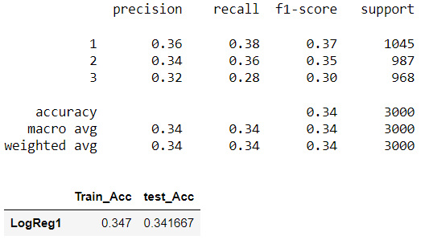
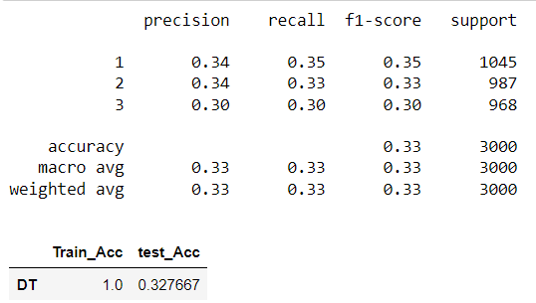
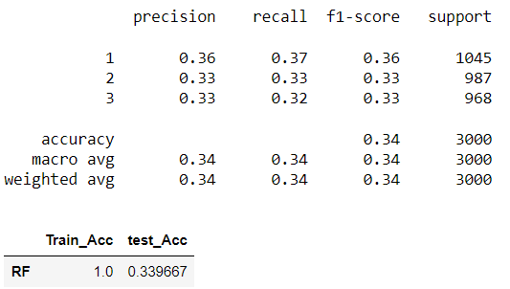
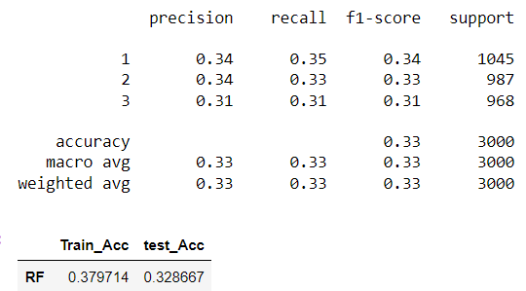
INSIGHTS
Logistic Regression
Decision Tree
Random Forest
Adaboost
This is one of the most significant to analyze the performance of the models, Overfitting occurs when the model learns the training data too well, including noise and outliers, and fails to generalize to new. AdaBoost classifier is similar to the Random Forest and Decision Tree models, indicating moderate improvement. The metrics suggest that the model is not overfitting as severely as the Decision Tree or Random Forest models since the training accuracy is closer to the test accuracy.

Slide 6
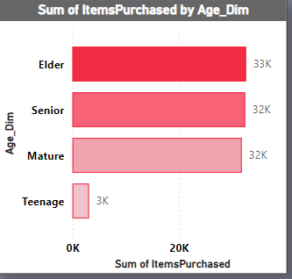
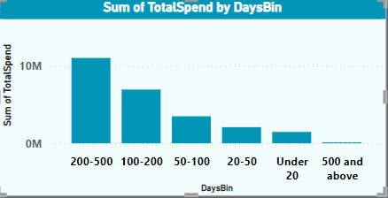
INSIGHTS
These tables allows us to visualize in a good manner. In the table of Sum of item purchased by age_dim , We are able to understand that which age criteria prefer more item purchased and from the above table we can see that our teenage customer is low than elder, senior and mature. In the table of total spend by daysBin , we are able to compare the last days Spend till now, so that we can consider in which days our sale is more.

Slide 7
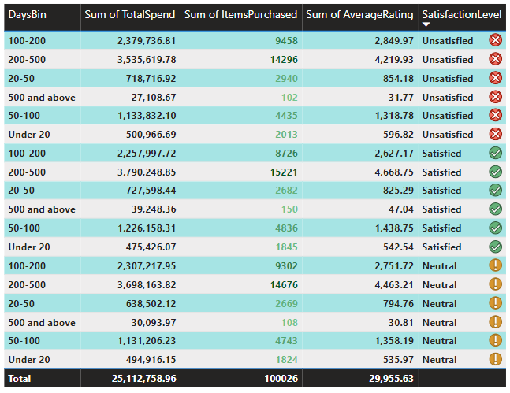
.
INSIGHTS
The purpose of this table is to visualize our sales and satisfactionlevel of our customers with respect to daybins, according to daysbin , we are able to compare total spend and total number of item purchased , We are also analyze the average rating of our customers to our services.

Slide 8
.
CONCLUSION
We have discovered useful information by utilizing Power BI and Machine Learning to analyze ecommerce sales. It provide us to analyze the data of eommerce and the reason behind the low sales or constant, reason behind no growth, for example from the above visualization we get idea about which age group people bought our products more , we analyze that teenage group spend low on our product so we have to deal less with the customer of teenage.
Trend Analysis: Looked at fund returns over time to identify patterns related to the seasons. Investment insights: purchasing trends and behaviors. Market Competitiveness: Assessed prospects for growth, positioning, and competition.
Data visualization: The intuitive presentation of complicated data. Interactivity: Made it possible to explore insights.
Scalability: Effectively handled big datasets. Generated insights that aided in prompt and well-informed decision-making. Next Actions:
Implementation: Convert research results into practical plans of action. Monitoring: Keep a close eye on market trends and analytics. Additional Analysis: Look into other angles to get fresh perspectives. Regards!

Slide 9


